Slide 1
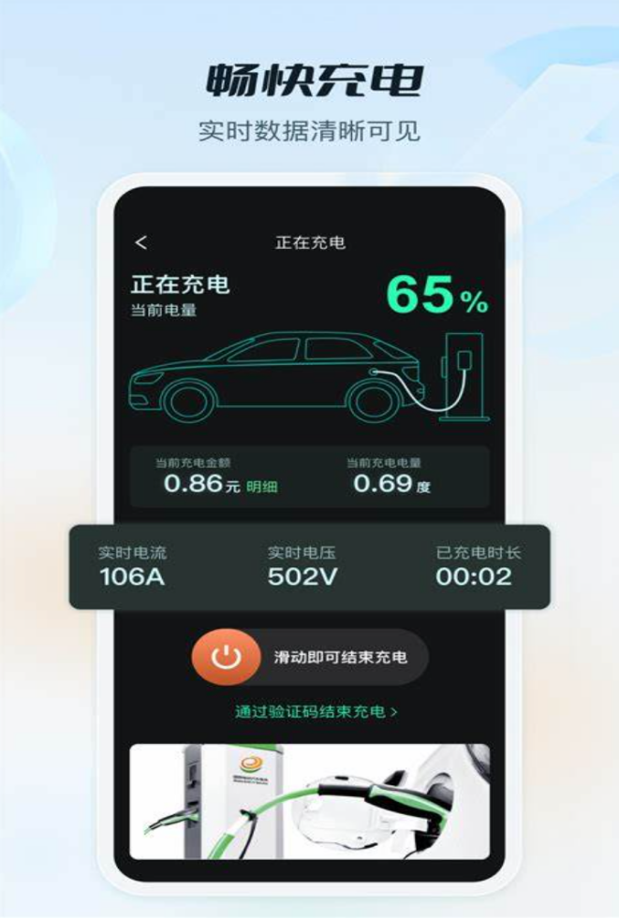

Echarging App: Revolutionizing EV Charging Experience
group members:赖旻臻 黄子恒 袁茵 卢子洋 reporters:黄子恒，赖旻臻

Slide 2
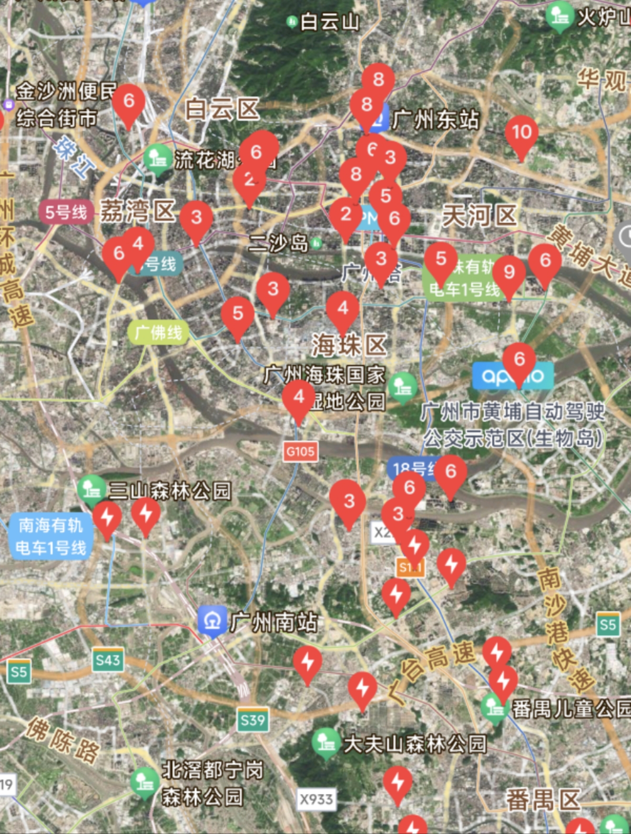
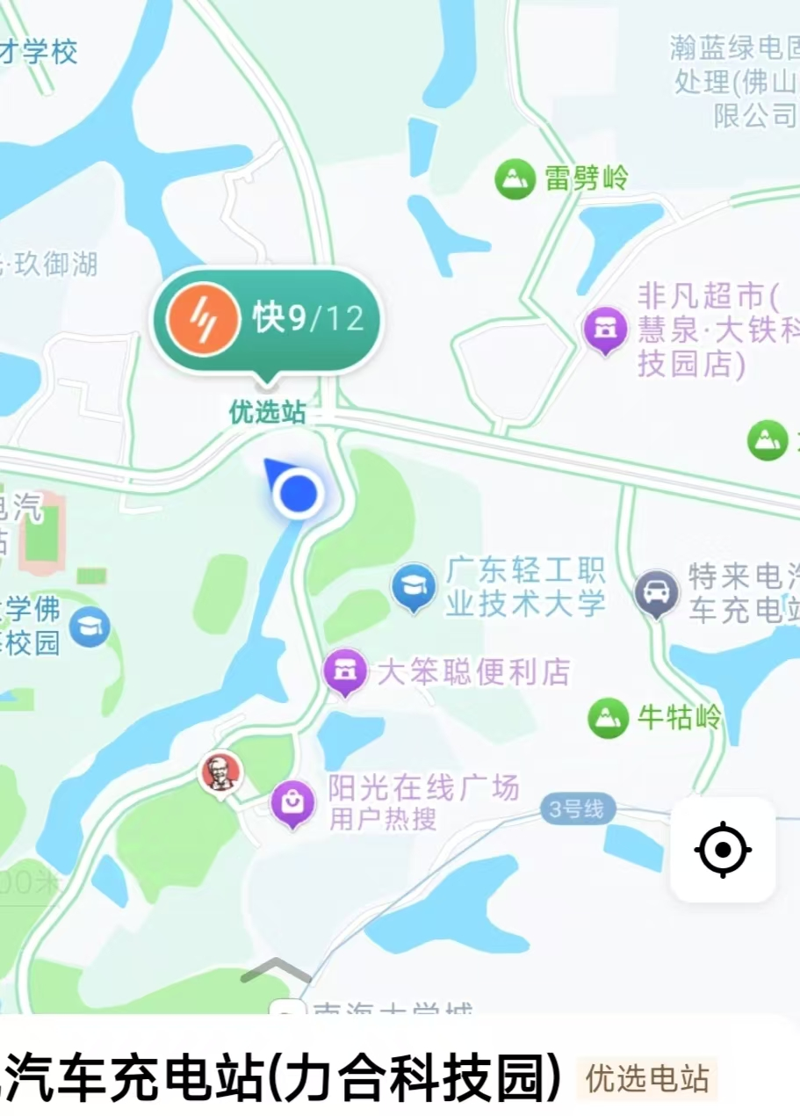
Echarging App Overview
1
Locate
Users can easily find nearby charging stations on an interactive map.
2
Check Availability
Real-time updates show which stations are currently available or in use.
3
Navigate
Built-in navigation guides users directly to their chosen charging station.
4
Monitor
Users can track their charging session progress and receive notifications.

Slide 3

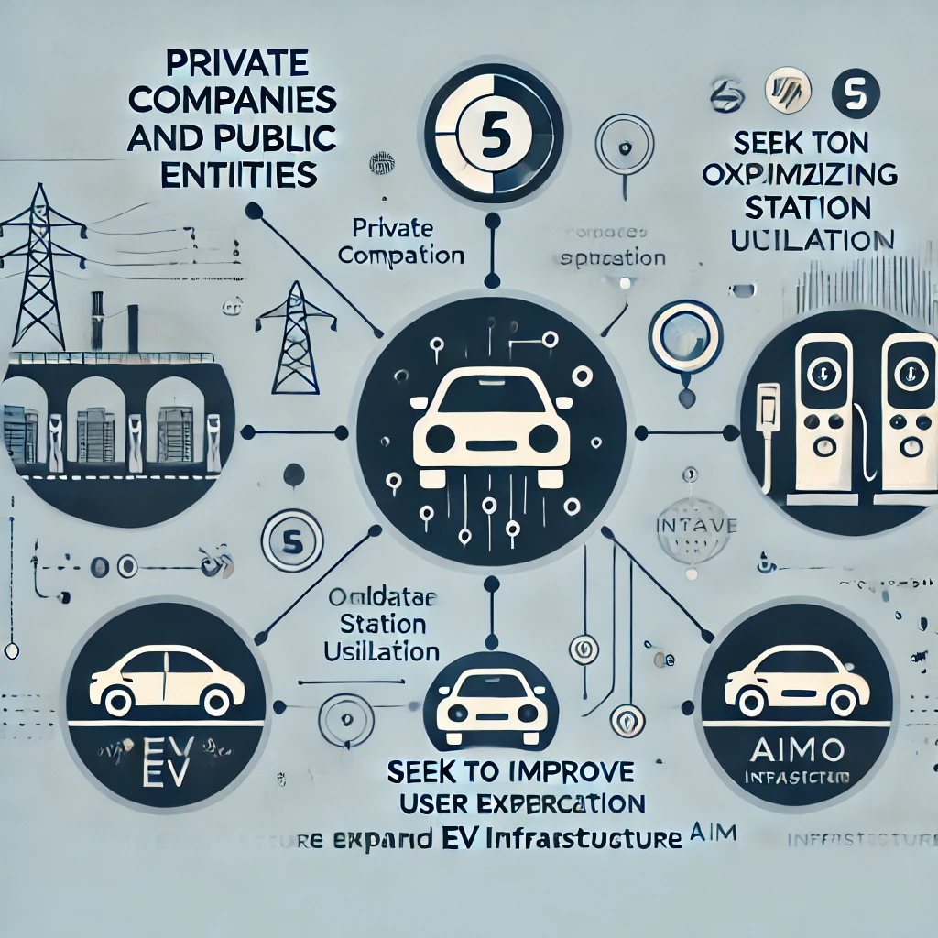

Target User Persona
Individual Users
Charging Network Operators
- Tech-savvy EV owners - Age range: 25-50 - Urban and suburban commuters - Value convenience and efficiency - Environmentally conscious
- Private companies and public entities - Focus on optimizing station utilization - Seek to improve user experiences - Interested in data-driven insights - Aim to expand EV infrastructure

Slide 4

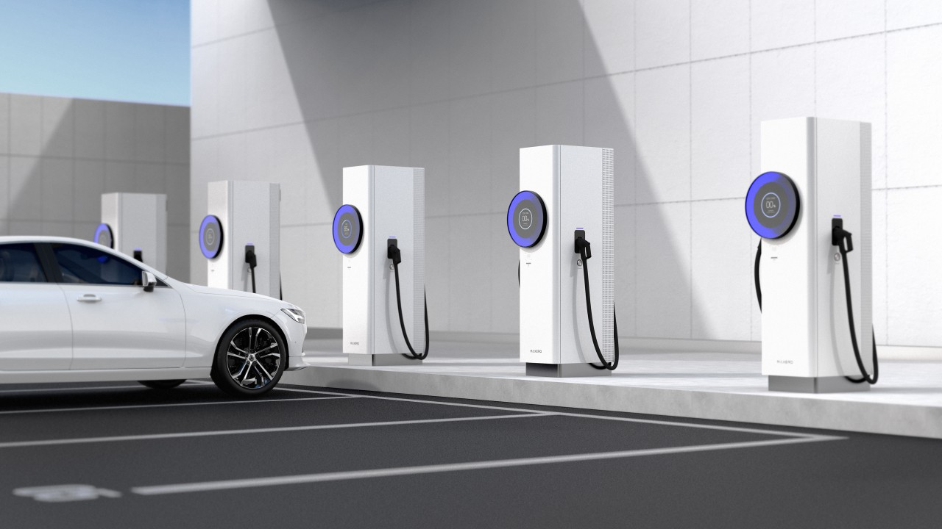
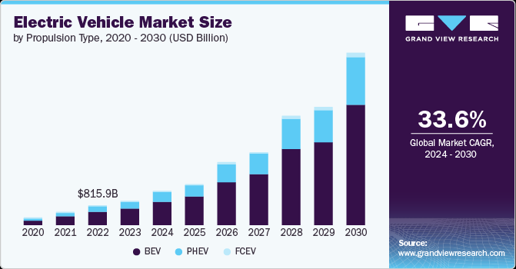
Market Analysis
1
Rapid EV Market Growth
The global EV market is projected to grow at a CAGR of over 25% in the next five years, driving demand for charging solutions.
2
Infrastructure Expansion
Government and private investments are accelerating the deployment of charging stations, creating opportunities for management platforms.
3
User Experience Focus
4
Data-Driven Insights
EV owners are increasingly demanding user-friendly, reliable apps to manage their charging needs efficiently.
The market is moving towards solutions that offer actionable insights for both users and charging network operators.

Slide 5
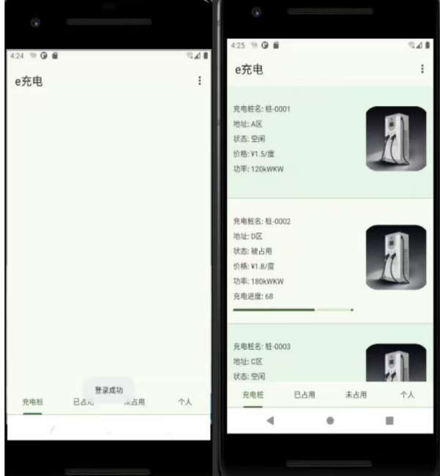
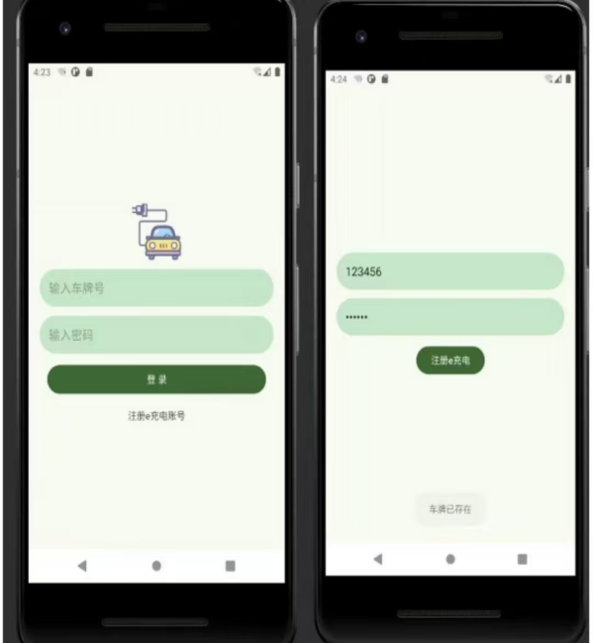
Unique Selling Proposition
Simplicity First
Clean, intuitive interface focused solely on essential charging information.
User Empowerment
Enabling confident decision-making for EV drivers through reliable data.
Real-Time Accuracy
Up-to-the-minute updates on station availability and status.
Privacy-Focused
Robust data protection measures to ensure user trust and security.

Slide 6

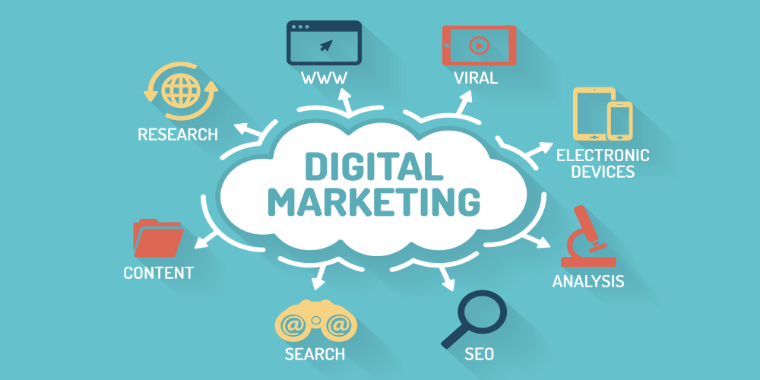





Marketing Channels
Social Media
Influencer Partnerships
Local Events
Email Marketing
Leverage platforms like WeChat, TikTok, and Xiaohongshu to engage with tech-savvy EV drivers.
Host and participate in EV-focused events to showcase the app and build community engagement.
Use targeted campaigns to keep users informed about new features and promotions.
Collaborate with EV enthusiasts and sustainability influencers to build trust and credibility.

Slide 7
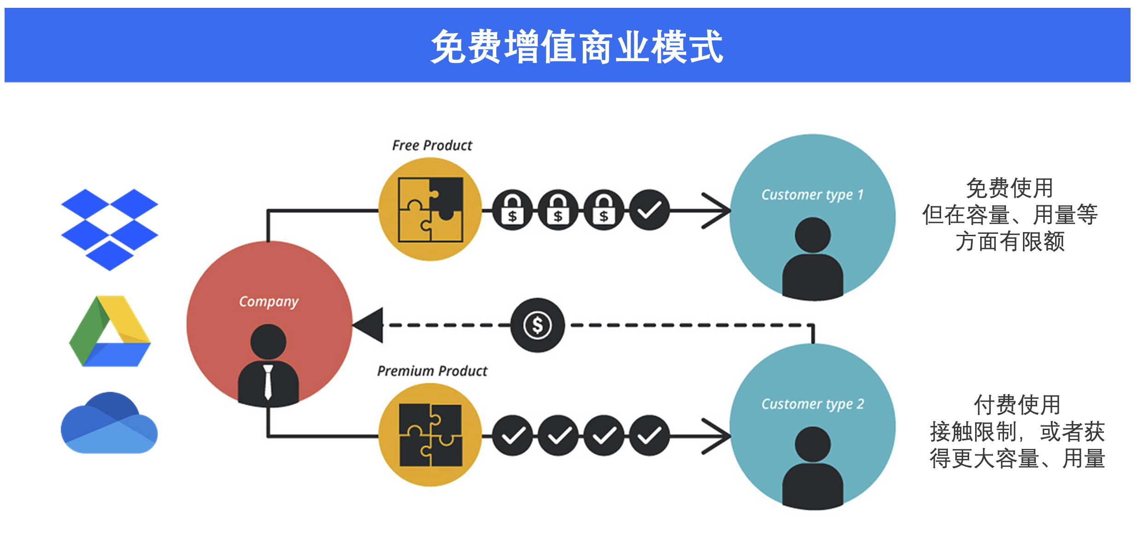

Financial Key Metrics
Metric
Year 1 Projection
Year 2 Projection
Total Users
10,000
25,000
Premium Subscribers
500 (5%)
1,750 (7%)
Annual Revenue
$2,500
$10,500
User Acquisition Cost
$2.50
$2.00

Slide 8




App Validation Strategy
Beta Testing
Market Research
A/B Testing
Feedback Loop
300 diverse users testing core features with specific usability metrics.
Surveys and focus groups to gather qualitative feedback on UI and features.
Optimize onboarding process and assess layout preferences.
In-app feedback option with regular updates addressing user input.

Slide 9

Risk Analysis
Technical Risks
Implement data verification processes and invest in scalable infrastructure to ensure app reliability and data accuracy.
Market Competition
Differentiate through superior user experience and real-time accuracy, while continuously innovating based on user feedback.
User Retention
Regulatory Changes
Focus on building a strong community through regular engagement, feature updates, and responsive customer support.
Stay informed about EV policies and adapt quickly to ensure compliance and capitalize on new opportunities.

Slide 10



Conclusion and Future Outlook
1
2
3
4
Launch
Expansion
Integration
Innovation
Initial app release with core features and user acquisition focus.
Broaden user base and enhance features based on feedback.
Partner with major EV manufacturers and charging networks.
Implement AI-driven predictive features and expand globally.

